Slide 1
Cochin University of Science & Technology
Cochin University College Of Engineering Kuttanad
PROJECT
Smart Online Voting System Using Cloud
Under The Guidance Of Radhika Ma’am
Presented By: Aman Kumar
Reg No:38220203

Slide 2
TABLE OF CONTENTS
CONTENTS | SLIDE NO
1.Introduction
2.Front End and Back End
3.Abstract
4.Existing System
5.Proposed System
6.Module Description
7.System Design
8.Data Flow Diagram
9.UML Diagram
10.Conclusion
11.Screenshot
References

Slide 3
Introduction
Before days and also till now there was voting system with papers. For conduction one simple village level election government have to spend so much rupees that is a biggest breaker of developing any country. And also voting with ballot papers are not good for perfect selection of leader or anything. Manual voting may lead to malpractices sometimes. so there is a need to implement online voting system. This is for expand the technology from manual voting system to digital voting system.
In this specific project my idea is to implement online voting system with features like the schemes that the specific party has implemented, based on the features we are going to vote. The main reason we need to shift from normal voting system to online voting system is that we can consume our time and can vote from anywhere through online. I am going to implemented this by using java as a programming language, Microsoft SQL and cloud.
. All the authorized and eligible persons can register through online and can vote by logging into their own systems. There is no time consuming for the users. The major advantage in this system is that the user has no need of coming to the voting halls, as they can vote from anywhere. It has more features as compared to the normal voting system. By this way most the people can cast their votes without missing.

Slide 4
Front end and Back end
Front end-> HTML, CSS, JavaScript
Back end->Java and MySql
In this Project for Front end we used HTML and CSS because these two languages are so good and well for designing any website and also easy to use and easy to implement these concept.
For Back end I will used Java and MySql because these languages are easily integrated with another language.
HTML stands for Hyper Text Markup Language and CSS stands for cascade style sheet. For learn and understand these language is so easy. Any one can easily understand because all things used in this is similar to normal English. And for learning this language no need to prior knowledge about any programming language. So we used these language.

Slide 5
ABSTRACT:
The project “Smart Online Voting System” aims at making the voting process easy in any type of elections.
Presently voting is performed using ballot paper and the counting is done manually, hence it consumes a lot of time.
There can be possibility of invalid votes. All these make election a tedious task. In recent times in India, due to elections the second wave of COVID transmission also made huge loss of human lives.
In our proposed system voting and counting is done with the help of computer in Online. It saves time, avoid error in counting and there will be no invalid votes. It makes the election process easy.

Slide 6
EXISTING SYSTEM
Existing system is a manual one in which users and the details of the candidates are stored in books.
The users have to wait a long time in queues for voting.
Wrong and unwanted votes are given.
Counting of votes are done manually which takes lots of time and inaccurate counting is done. It is very difficult to maintain historical data.
In the existing system, there is compulsory need in physical presence in the time of election polling or vote counting.

Slide 7
DISADVANTAGES OF EXISTING SYSTEM
If elections are conducted in existing system model in the pandemic time, then there is sure spread of disease like COVID, which happened in the recent elections in India.
It is difficult to maintain important information in books.
More manual hours are needed for counting of votes.
It is tedious to manage historical data which needs much space to keep all the information regarding the voters and the candidates.
Voters have to wait in long queues for voting they have to travel long distances.

Slide 8
PROPOSED SYSTEM
The Online Voting System is a software application which avoids more manual hours that need to spend in record keeping and calculating votes.
Through this the users and the candidates are registered online. Their information is stored in the database the admin can easily access the details of the voters and the candidates.
The voters are allowed to vote online they can even vote by sitting at home. Every User allowed to vote only once so there is no chance of duplicated votes.

Slide 9
ADVANTAGES OF PROPOSED SYSTEM
The objective of the VOTING SOFTWARE is to provide better information for the users of this system easily they can vote from anywhere without facing any difficulty.
The proposed system does not require any physical presence during vote polling or counting. So it is very easy to conduct elections even during the pandemic situations without any spread of disease or human live losses.
The proposed system has good authentication so only authorized person can able to vote and also cannot vote multiple types.
Vote Counting can be made very quickly and results will be displayed in few minutes.

Slide 10
HARDWARE REQUIREMENTS
System : Pentium i3 Processor
Hard Disk : 500 GB.
Monitor : 15’’ LED
Input Devices : Keyboard, Mouse
Ram : 2 GB

Slide 11
SOFTWARE REQUIREMENTS
Operating system : Windows 10.
Coding Language : JAVA.
Tool : Netbeans 8.2
Database : MYSQL

Slide 12
MODULES:
Admin Module
Add Elections
Add Candidate.
View Voter and approve voters
View the Vote and results
Voter Module
Voter Registration
View Candidate details
Vote

Slide 13
MODULES DESCSRIPTION:
Admin Module :
This module has to maintain the information of the candidate and shows the details of the candidate. And also maintains the records of the party and the candidate.
Add Elections
Description: This module the admin can able to create new elections. The elections will be set with the date and so after that date the voters cannot able to vote to that particular election.
Add Candidate
Description: This module the admin can able to add the candidates who are going to constitute in the particular election. First they need to select the name of the election, then add candidate name, Party name, Address, Contact number, Photo etc. Once these added, then the voter can able to see the candidate details in their login.

Slide 14
MODULES DESCSRIPTION:
View voter and approve Voters:
Description: In this sub module we can view the entire details of the voters coming from the users who are registered. The admin can able to verify and approve or reject it accordingly. Once the admin approves it, then the user gets notified.
View the vote and results:
Description: In this sub module we can get the results of the election i.e who had won the election with how many votes.
Voter Module :
This allows user to vote for the respective candidate and allows the user to view the candidate details, allows user to view the details of the respective person he voted for.

Slide 15
MODULES DESCSRIPTION:
Voter Registration:
Description: In this sub module the voter register themselves by add the details such as Name, Date of birth, email id, gender, Phone Number, address, password. Once the voter registers, then the admin should view it and approve it, then only the voter can able to vote in the election. The voter will get notified by email if the admin approves or rejects their registration.
View Candidate details:
Description: In this sub module we can view the details of the candidates who constitute in the election with their photo, party details etc.
Vote:
Description: In this sub module we can register our vote. Once the user has registered his vote then again he is not allowed to vote again i.e. only one user can vote only at one time.

Slide 16
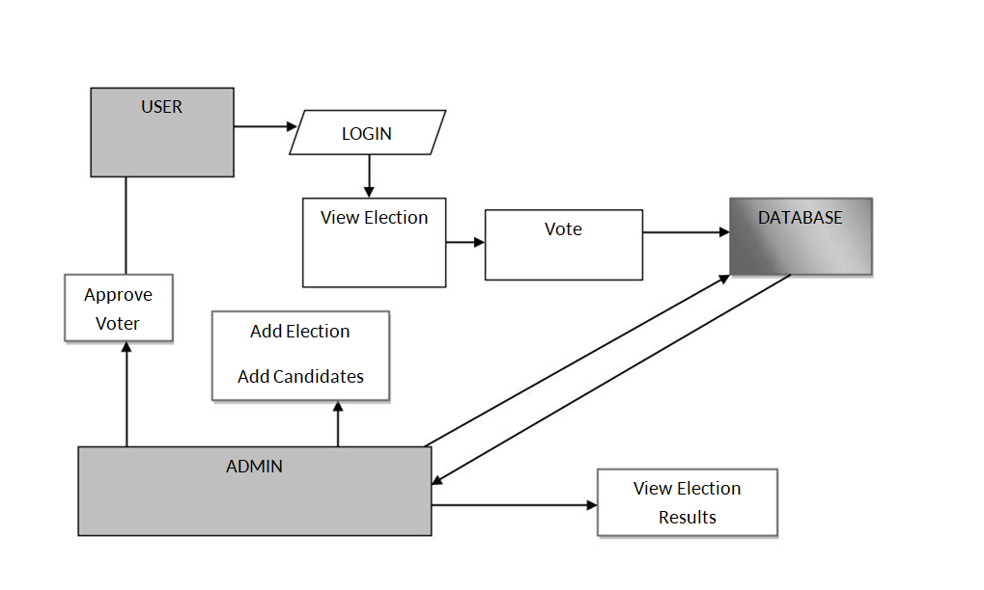
SYSTEM DESIGN
System Architecture:

Slide 17
DATA FLOW DIAGRAM:
The DFD is also called as bubble chart. It is a simple graphical formalism that can be used to represent a system in terms of input data to the system, various processing carried out on this data, and the output data is generated by this system.
The data flow diagram (DFD) is one of the most important modeling tools. It is used to model the system components. These components are the system process, the data used by the process, an external entity that interacts with the system and the information flows in the system.
DFD shows how the information moves through the system and how it is modified by a series of transformations. It is a graphical technique that depicts information flow and the transformations that are applied as data moves from input to output.

Slide 18
DFD FOR USER
User Register
.
Approve
No
Unauthorized user
Yes
Get Voter ID
Login Using Voter ID
View Elections
View Candidate Details
Vote
End Process

Slide 19
DFD FOR ADMIN
Admin Login
Check
No
Unauthorized user
Yes
View Voter Details
Approve Voters
Send Voter ID
Add Elections
Add Candidates
End Process

Slide 20
UML DIAGRAMS
UML stands for Unified Modeling Language. UML is a standardized general-purpose modeling language in the field of object-oriented software engineering. The standard is managed, and was created by, the Object Management Group.
The goal is for UML to become a common language for creating models of object oriented computer software. In its current form UML is comprised of two major components: a Meta-model and a notation. In the future, some form of method or process may also be added to; or associated with, UML.
The Unified Modeling Language is a standard language for specifying, Visualization, Constructing and documenting the artifacts of software system, as well as for business modeling and other non-software systems.

Slide 21
USECASE DIAGRAM
Registration
Approve User
in
Send Voter ID
Get Voter ID
User
Add Elections
Admin
Add Candidates
Login Using Voter ID
View Election
View Candidate Details
Vote
View Election Results
Logout

Slide 22
Class Diagram
User
Admin
Login
Login
Get Voter ID ()
View Election ()
View Candidate Details ()
Vote ()
View Voter Details ()
Approve Voter ()
Send Voter ID ()
Add Election ()
Add Candidates ()
View Election Results ()

Slide 23
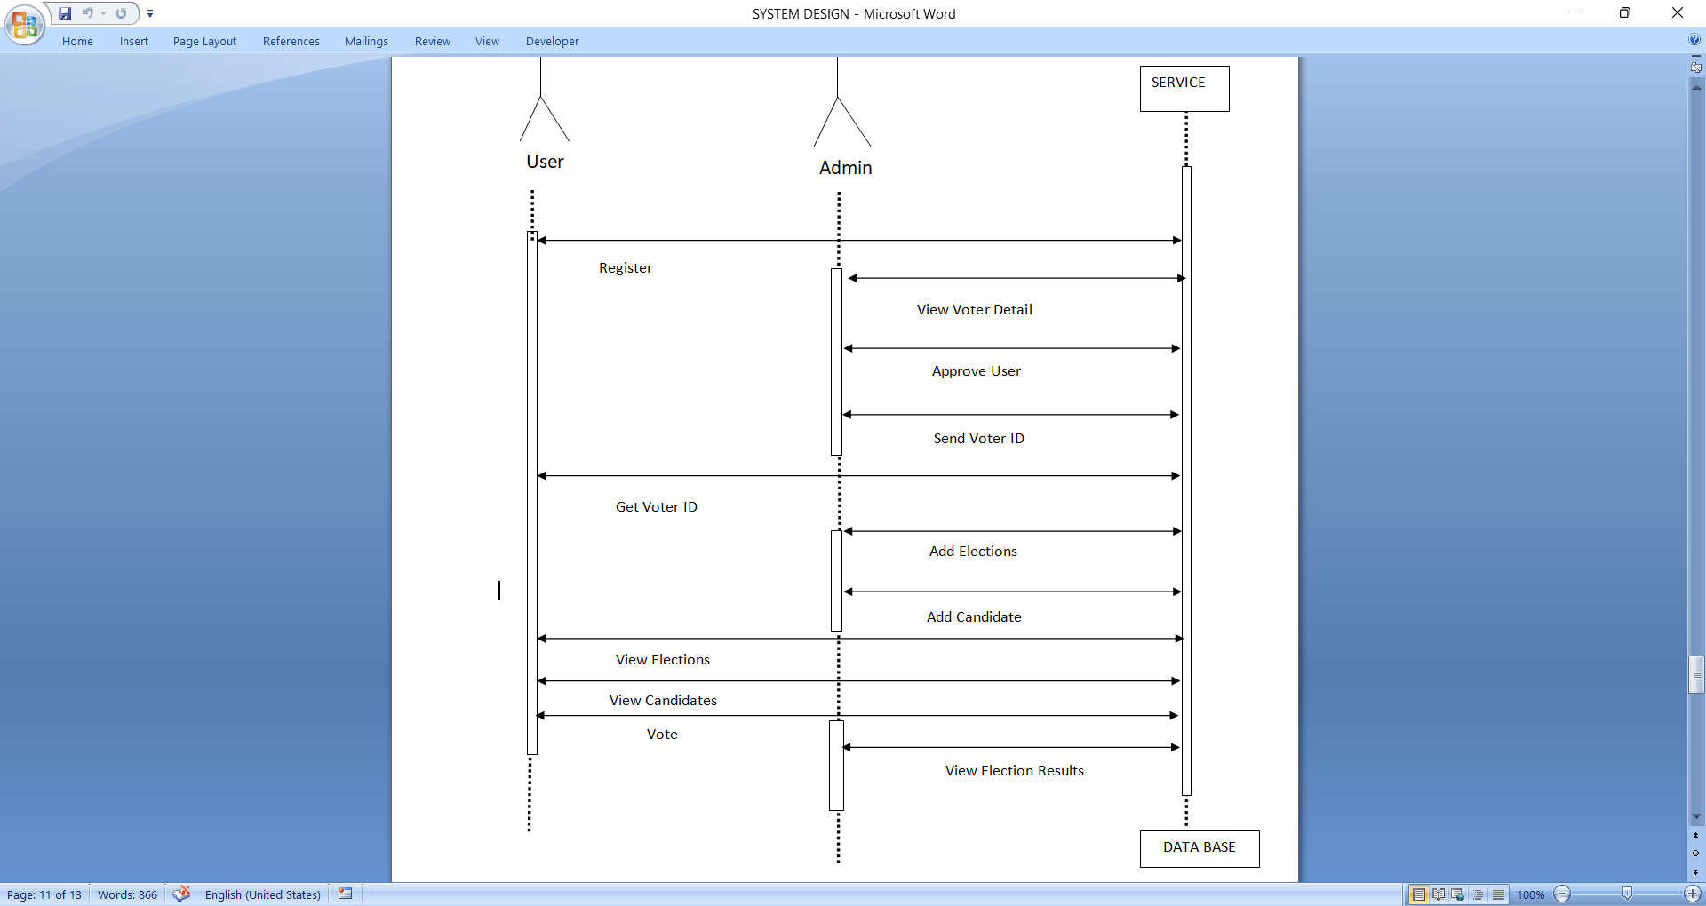
SEQUENCE DIAGRAM
Service

Slide 24
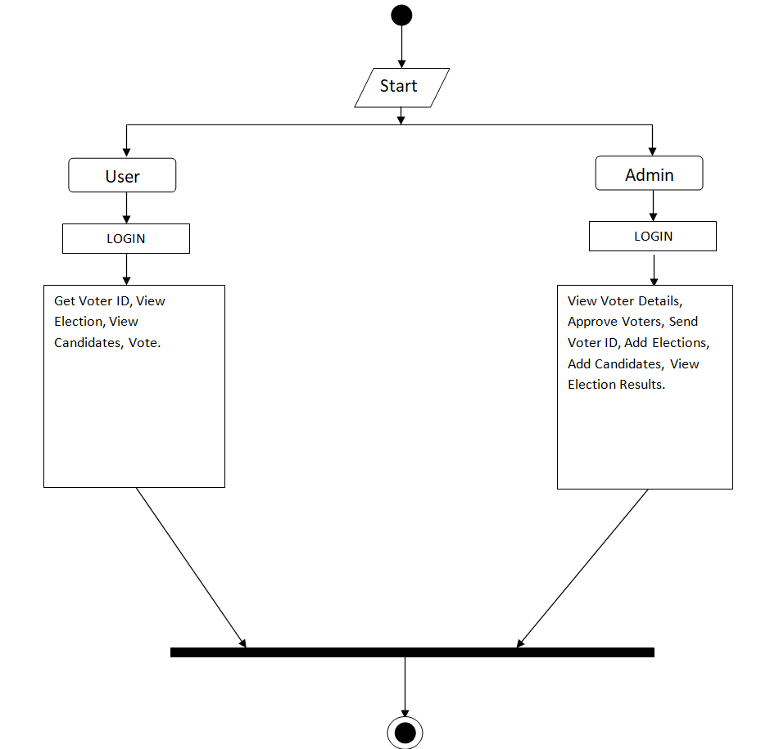
Activity Diagram

Slide 25
CONCLUSION
The “Smart Online Voting System” is successfully designed and developed to full fill the necessary requirements as identified in the requirements analysis phase, such as the system is very much user friendly, and performing very efficiently.
The old manual system was suffering from a series of drawbacks. The “Smart Online Voting System” project has been developed to meet the aspiration indicated in the modern age.

Slide 26
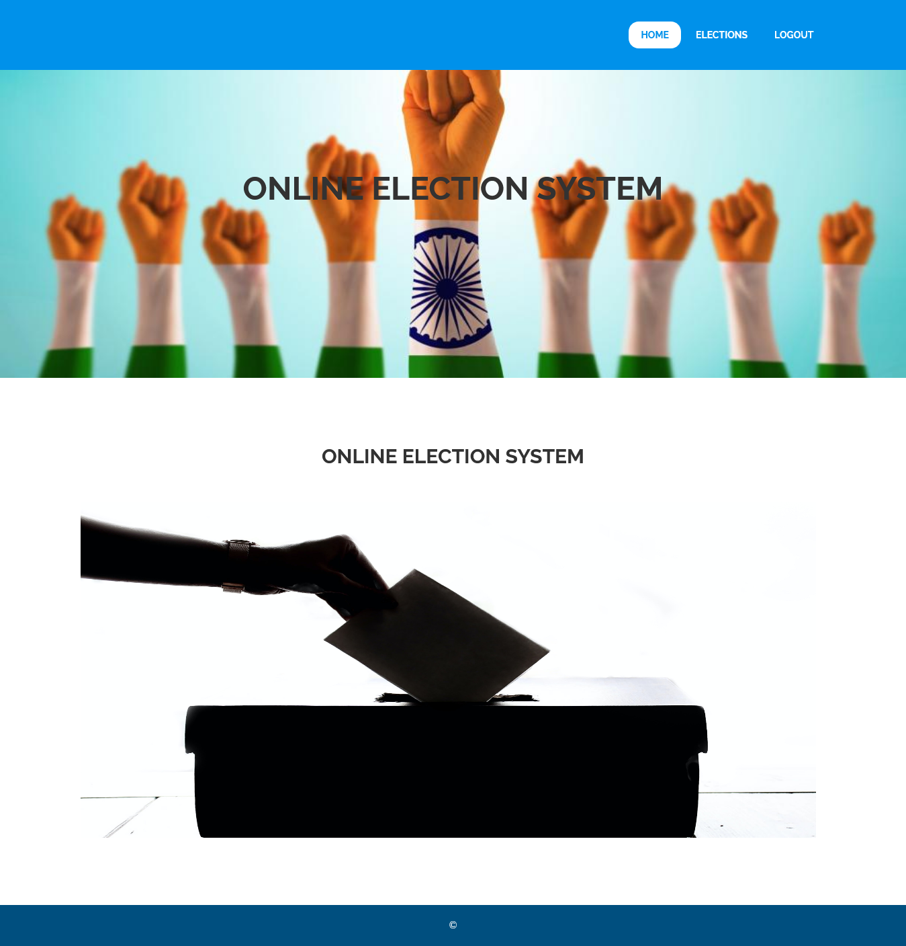
SCREENSHORT

Slide 27
REFERENCES
[1]. Malwade Nikita, PatilChetan, ChavanSuruchi, Prof. Raut S. Y, Secure Online VotingSystem Proposed By Biometrics AndSteganography, Vol. 3, Issue 5, May 2017.
[2]. AnkitAnand, PallaviDivya, AnEfficient Online Voting System, Vol.2,Issue.4, July-Aug. 2019, pp- 2631-2634.
[3]. Alaguvel.R, Gnanavel.G, Jagadhambal.K,Biometrics Using Electronic Voting System withEmbedded Security, Vol. 2, Issue. 3, March2018.
[4]. Firas I. Hazzaa, SeifedineKadry, OussamaKassemZein, Web-Based Voting System UsingFingerprint: Design and Implementation, Vol.2, Issue.4, Dec 2019.
[5] Alexander. Stakeholders: Who is yoursystem for? IEEE: Computing and ControlEngineering, 14(1):22{26,April 2003}.

Slide 28
THANK YOU

